Slide 1
PhonePe Transaction Insights
Data Analytics Project
Python | SQL Server | Streamlit | Power BI

Slide 2
Project Overview
Analyzed PhonePe transaction data
Studied transactions, users, and transaction value
Used Python, SQL Server, Streamlit, and Power BI
Created business insights and interactive dashboards

Slide 3
Technology Stack
🐍 Python & Pandas — Data Cleaning
🗄️ SQL Server — Data Storage & Queries
📊 Power BI — Data Visualization
🌐 Streamlit — Interactive Dashboard
📈 Plotly — Interactive Charts & Maps

Slide 4
Data & Methodology
Source: PhonePe Pulse Dataset
Extraction: Python
Processing: Pandas for data cleaning
Analysis: SQL Server + Pytho
Data → Python → Pandas → SQL Server → Visualization

Slide 5
Business Cases
Transaction Analysis
User & Device Analysis
Insurance Analysis
State-wise Analysis
Growth & Trend Analysis

Slide 6
SQL Server Analysis
Stored PhonePe data in SQL Server
Created tables for transactions, users, and insurance
Used SQL queries for business analysis
Calculated KPIs and trends from the database
SQL → Analysis → Business Insights

Slide 7
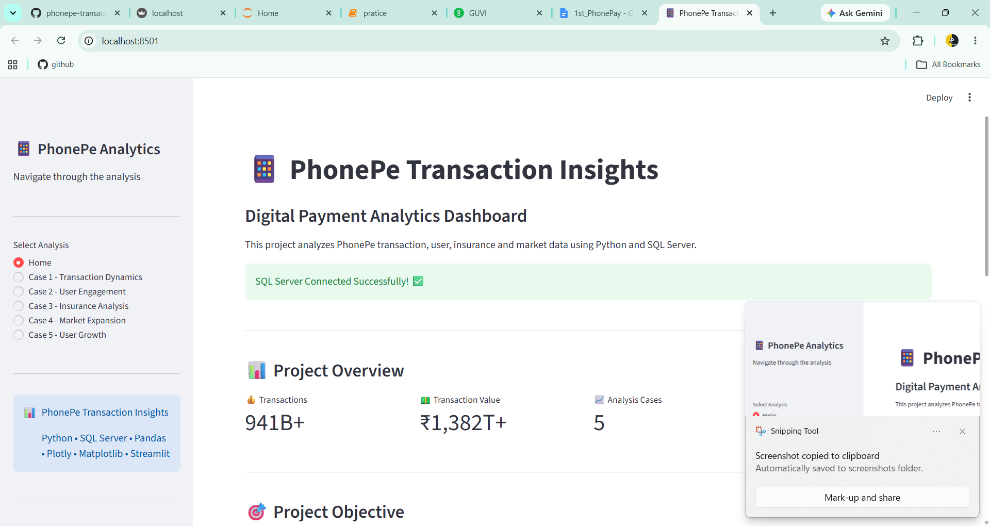
Streamlit Dashboard
Interactive KPI cards
Filters for data exploration
Interactive charts and India maps

Slide 8
Key Business Insights
Transaction: PhonePe has very high transaction volume and value.
User: User activity varies significantly across states.
Insurance: Insurance transactions show strong digital adoption.
Geography: Maharashtra and Karnataka are among the major transaction markets.
Trend: Digital transactions show strong growth over time.

Slide 9
Project Outcome
Built a complete ETL and analytics pipeline
Connected Python with SQL Server
Developed an interactive Streamlit dashboard
Generated data-driven business insights
Data → Analysis → Visualization → Insights

Slide 10
Conclusion
Successfully analyzed PhonePe transaction data
Combined Python, SQL Server, Streamlit, and Power BI
Created useful business insights through data analytics

